Slide 1
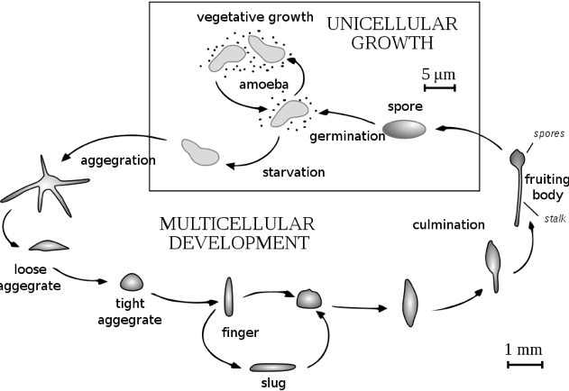
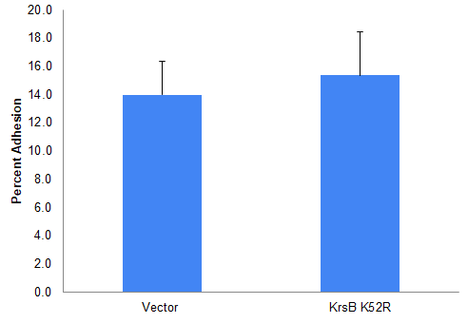
The Role of Talin A in KrsB-mediated Adhesion of Dictyostelium discoideum
Andrew Nearbin, Dr. Yulia Artemenko
Department of Biological Sciences, SUNY Oswego, Oswego NY
ABSTRACT
HYPOTHESIS
DISCUSSION AND CONCLUSIONS
Dictyostelium discoideum serves as an excellent model organism for the study of various cellular processes, including migration. Kinase responsive to stress (KrsB) regulates migration by inhibiting adhesion of cells to the surface; however, the molecular mechanism of KrsB action is unclear. Previous research has demonstrated that Talin A, an important cytoskeletal protein for cell to substrate contact in various systems, is involved in basal adhesion of D. discoideum. We hypothesized that KrsB-mediated effects on adhesion depend on Talin A. To address this question we examined whether catalytically inactive KrsB (K52R), which is known to increase adhesion, can do so in the absence of Talin A. We transformed Talin A-null cells with GFP-tagged KrsB K52R or empty vector by electroporation and checked cells using fluorescence microscopy to confirm expression. Following this we completed adhesion assays to compare the two cell lines. There were no significant differences between adhesion of Talin A-null cells with or without KrsB K52R. Although this preliminary data suggests that Talin A may be required for increased adhesion in the absence of active KrsB, further research is still needed to confirm these findings.
We hypothesize that KrsB is affecting the ability of Dictyostelium cells to adhere through Talin A.
Transformation
Electroporation provided the ability of the cells to incorporate the gene carried by the vector into their DNA.
Electroporation showed little to no complications.
Expression Check
Talin A-null cells were successfully transformed and showed good expression of KrsB K52R.
Adhesion Assay
Statistical analysis using a t-test indicated no significant difference between adhesion of the two cell lines
METHODS and RESULTS
Electroporation of Dictyostelium
Talin A-null cells were counted from a shaking culture.
The number of cells needed were transferred into a 15mL tube, with 5x10⁶ cells for each transformation.
The cells were spun down at 1500 rpm for 4-5 minutes. Supernatant was removed and cells were washed with cold H-50 buffer.
After washing cells were resuspended in cold H-50 Buffer a density of 5x10⁷ cells/mL and placed on ice.
100 µL of cells in H-50 Buffer were pipetted into a cuvette.
The cuvette was placed into the electroporator and pulsed twice with a 5 second interval between the pulses.
The cells and buffer were transferred into a plate with growth media and placed in a 20℃ incubator overnight.
The next day cells were changed and antibiotic drug G418 was added to select transformed cells.
INTRODUCTION
Dictyostelium is a social amoeba that can transform from single unicellular amoebae into a multicellular slug.1
Since Dictyostelium movement is similar to mammalian cells, it has homologous genes, and it is easily manipulated in the laboratory, it is the ideal model organism for studying migration.³
Studies using Dictyostelium can have profound implications in the fight against cancers that metastasize and other pathophysiological conditions, such as atherosclerosis.²
Figure 2. Electroporator used for transformation of Dictyostelium cells.
FUTURE WORK
Expression Check
Wild-type cells expressing KrsB K52R or vector will be tested in an adhesion assay to determine which assay conditions are optimal to show the effect of KrsB K52R on adhesion.
If wild-type cells expressing KrsB K52R do not have the expected increased adhesion under the conditions used in this study, then analysis of Talin A-null cells expressing KrsB K52R or vector will be repeated under conditions where KrsB K52R has an effect.
Testing of Talin B-Null cells will also be carried out to determine the role of this isoform in KrsB effects on adhesion.
Brightfield
GFP
After more than one week of selection, cells were checked for proper expression of the vector and KrsB K52R using an LSM700 Confocal Microscope the under a 63x oil objective.
Vector
KrsB K52R
(Adapted from https://en.wikipedia.org/wiki/Dictyostelium_discoideum)
REFERENCES
KrsB
Figure 3. Expression of GFP-tagged KrsB K52R or vector encoding GFP alone in Talin A-null cells. Cells were imaged on an LSM700 Confocal Microscope under a 63x oil objective.
dictyBase. Dictyostelium discoideum: Model System in Motion. http://dictybase.org/tutorial/ (accessed July 14th, 2020).
Artemenko, Y., Batsios, P., Borleis, J., Gagnon, Z., Lee, J., Rohlfs, M., Sanseau, D., Willard, S., Schleiher, M., & Devreotes, P. (2012). Tumor suppressor Hippo/MST1 kinase mediates chemotaxis by regulating spreading and adhesion. PNAS, 13632-13637. doi: 10.1073/pnas.1211304109.
Niewöhner, J., Weber, I., Maniak, M., Müller-Taubenberger, A., & Gerisch, G. (1997). Talin-Null Cells of Dictyostelium Are Strongly Defective in Adhesion to Particle and Substrate Surfaces and Slightly Impaired in Cytokinesis. Journal of Cell Biology, 138(2), 349-361. doi:10.1083/jcb.138.2.349
Plak, K., Pots, H., Haastert, P. J., & Kortholt, A. (2016). Direct Interaction between TalinB and Rap1 is necessary for adhesion of Dictyostelium cells. BMC Cell Biology, 17(1). doi:10.1186/s12860-015-0078-0
Kinase responsive to stress B (KrsB) is a homolog of tumor suppressors.
KrsB is known to be a negative regulator of the cell’s ability to adhere to a substrate. ³
The molecular mechanism of how KrsB regulates adhesion is unknown.
Adhesion Assay
Talin
Cells were collected into tubes and counted.
Calculated amount of cells was pipetted into wells of a 6-well plate in HL-5 media based on a concentration of 1x10⁶ cells per well.
Cells were grown overnight.
The next day, media was replaced with 3 mL of fresh HL-5 media.
After 1 hour incubation cells were shaken for 1 hour at 150 RPM.
1 mL of floating cells was collected and the rest was aspirated.
Adherent cells were washed and collected with 1mL DB.
Cells were counted and numbers of floating and adherent cells were calculated
Adhesion was calculated as follows:
% adhesion = (# of adherent cells / total # cells) x 100%
Talin is a cytoskeletal protein that is essential for adhesion to substrates in both mammalian and Dictyostelium cells.
There are two isoforms found in Dictyostelium: Talin A and Talin B. Cells lacking TalA (talA-) show a reduced adhesion to substrates. Cells that are lacking TalB (talB-) show an inability to form tips on the mound or move due to weaker motile forces^{.4}
Figure 1. Talin at sites of adhesion in mammalian cells. Integrin attaches to talin, which links to the actin cytoskeleton.
Figure 4. Adhesion assay results for Talin A-null cells expressing GFP-tagged KrsB K52R or vector. Percent adhesion was calculated as a number of adherent cells divided the total number of cells, times 100. Data shown as mean +/- SD, n = 3. A two-tailed, paired t-test showed no significant differences between means.
ACKNOWLEDGMENTS
I would like to thank and acknowledge Dr. Yulia Artemenko and the SUNY Oswego Department of Biology for supporting my research. The research was possible thanks to the funding NSF-RUI grant no. 1817378 (to Y.A.)
https://www.nature.com/articles/ncb0803--694
Notes:
https://www.nature.com/articles/ncb0803-694

